Slide 1
^{KNOW YOUR RIGHTS}
A Guide to Your Rights When Interacting with Law Enforcement
Notes:
NOTE TO INSTRUCTORS: Power point notes contain a sample presentation. We encourage you to personalize and make the presentation interactive wherever possible.
NOTE TO INSTRUCTORS: Make sure participants have all materials prior to the presentation so they can reference them and make notes throughout.
In this training you will learn:
1) What you need to know and what to do when encountering immigration officers, the police, or the FBI in different places
2) Twelve things for you and your family to remember in ANY situation
3) How to make an emergency plan for your family. You will receive your own emergency planning checklist.
4) What emergency contact information you must have on hand at all times. You will receive your own emergency contact information sheet to fill out.
5) What questions to ask if a loved one calls you from immigration detention or police custody,
AND
6) How to protect yourself and your coworkers in a raid on your workplace. You will receive a workplace planning checking.

Slide 2
YOU HAVE RIGHTS regardless of your immigration status
To protect yourself and your family, you must know your rights.
Notes:
You have rights regardless of your immigration status.
If is very important to know that you may be at particular risk of being deported if:
You are undocumented
You have a criminal history
You are on parole
You have a prior deportation order
This information is not intended to frighten you. You must know the facts and your rights to best protect yourself and your family.

Slide 3
ACT NOW. Knowledge Is Power. Do Not Wait. Be Prepared.
Notes:
NOTE TO INSTRUCTORS: Suggested Exercise - Ask for volunteers to do a role play about what to do if ICE or the police comes to their home. The instructor should play the officer.
Alternatively, the instructor could have a volunteer explain what they would do, step-by-step.
The instructor should analyze the scenario. For example, “Opening the door may mean giving the police permission to enter your home. As you will learn later in this presentation, you must never open the door unless police have provided you with a valid warrant.”
The exercise will help illustrate the difference between being unprepared vs. the power of knowing your rights and knowing what to do in an emergency.

Slide 4
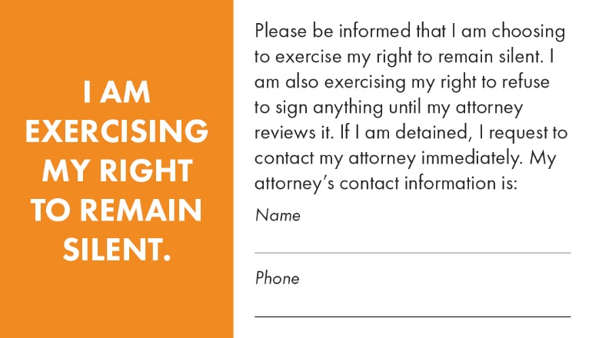
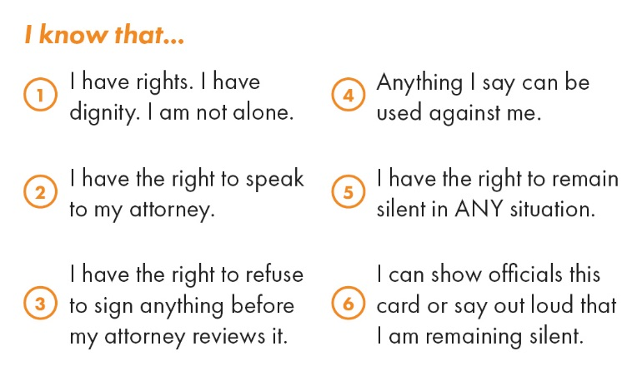
KNOW YOUR RIGHTS CARD
Notes:
During this presentation, we will be referring to your Know Your Rights card often. This card is intended to help you remember and express your rights during a raid or other interaction with the police, immigration officers, or the FBI.
NOTE TO INSTRUCTORS: Hand out cards or scissors to participants so they can have their cards during the remainder of the presentation.

Slide 5
WHERE: Your Home
Two ways to enter your home:
valid warrant
your permission
DO NOT OPEN THE DOOR
ALWAYS ASK FOR IDENTIFICATION
ASK TO SEE A WARRANT
You have the right to remain silent
Notes:
What You Need to Know:
To enter your home, immigration officers or the police need either 1) a valid warrant signed by a judge or magistrate OR 2) your permission.
DO NOT OPEN THE DOOR. Opening the door could mean you give the officers permission to enter your home.
A warrant DOES NOT mean you have to answer questions.
If immigration officers or the police are questioning you and you wish to remain silent, say out loud that you wish to remain silent or show the officials your Know Your Rights card.
What to do:
Step 1: DO NOT OPEN THE DOOR.
Step 2: ASK FOR IDENTIFICATION. Officers may try to trick, frighten, or intimidate you to get into your house. Look through a window to see their identification. Do not be caught off guard and open the door.
Step 3: Ask the officials if they have a warrant.
Step 4:
If the officials DO NOT have a warrant, they do not have the right to enter your home. You can ask them to leave.
If the officials have a warrant, you have a right to see it. Ask the officers to slide the warrant under the door or put it up to your window. Remember, do not open the door!
Step 5: Read the warrant carefully. There are different types of warrants. What to do will depend on what type of warrant it is. Each warrant must have certain information. If the warrant does not have the information that is required, it is not valid. This means the officers do not have authority to enter your home.
IMPORTANT: Warrants may look different depending on your state or location. We will go through examples of the different types of warrants now. Remember, what is important is that the warrant contains the information necessary to make it valid.

Slide 6
A Valid Search Warrant
Must be signed by a judge, justice of the peace or magistrate
Must contain the address of the home to be searched
Must describe the area to be searched
If officers enter your home, say “I DO NOT CONSENT TO YOU SEARCHING MY HOME.”
A Valid Arrest Warrant
Must be signed by a judge, justice of the peace or magistrate
Must state the name of the person to be arrested
Must describe the person to be arrested
Notes:
NOTE TO INSTRUCTORS: Have attendees look at sample warrants to review.
A valid search warrant:
Must be signed by a judge, justice or the peace or magistrate.
Must state the address of the home to be searched.
Must state in detail the area to be searched. In some cases, search warrants may be many pages long describing locations to be searched.
NOTE TO INSTRUCTORS: The sample search warrant in the packet is just a first page. You will see that the first page states that there are multiple pages.
If the officer does not have a valid warrant you can say, “This is not a valid warrant. You may not enter my home. Please leave.”
If the officer has a valid warrant, you must allow them to enter your home. When they enter your home say “I do not consent to you searching my home.” This should limit where they are allowed to search.
Observe where the officers search. Observe if they search in areas they do not have permission to search in the warrant. Repeat that you do not consent to the search. If an officer takes any of your property, ask for a receipt.
A valid arrest warrant:
Must be signed by a judge, justice of the peace or magistrate
Must state the name of the person to be arrested
Must describe the person to be arrested
If the officer does not have a valid warrant you can say, “This is not a valid warrant. You may not enter my home. Please leave.”
If the officer has a valid arrest warrant and the person named in the warrant is home, that person should go outside to meet the officer. Close the door behind them. If the person named in the warrant is not home, tell the officer that the person is not there and do not open the door.

Slide 7
A warrant of removal/deportation (immigration warrant)
≠
The right to enter your home.
Notes:
A warrant of removal or deportation (an immigration warrant) DOES NOT give an officer the right to enter your home. Say, “You do not have the right to enter my home with this warrant. Please leave.”

Slide 8
If officers enter your home
Inform them if there are children, elderly, or sick people in the house
Say that you do not consent!
Pay attention to where officers search
Write down what happens as soon as they have left
Notes:
If the officer enters your home (with or without a valid warrant) inform them if there are children, elderly, or sick people in the house.
Say that you do not consent (you can say this even if they have a valid warrant but it is essential to say this if they do not have a warrant or if they do not have a valid warrant)
Pay close attention to everything that happens. After they have left, write down exactly what happened in as much detail as possible. Include the type of officers (for example, immigration officers or the police), their names, badge numbers, and the names and contact information of anyone who witnessed what happened.

Slide 9
WHERE: The Street or Public Area
DO NOT RUN
Before saying anything, ask “AM I FREE TO GO?”
You have the right to remain silent
In some states, you may have to give your name
If searched, say “I DO NOT CONSENT TO THIS SEARCH.”
Notes:
What you need to know:
Do not run if you see immigration officers or the police approaching you.
Just like at home, if you are stopped on the street or in a public area, you have the right to remain silent and not answer questions.
In some states, the law says that you must tell the police your name if they ask.
NOTE TO INSTRUCTORS: Look up the law in your state prior to the presentation. These laws are typically known as “stop and identify statutes.”
In general, an officer needs a warrant to arrest you. In some situations you could be arrested if the officer has evidence you do not have legal status or if you have committed a crime.
In some situations, officers have the right to search you to make sure you are not carrying weapons or illegal materials. Do not resist this inspection.
If you are in an airport or near the United States border, you may be questioned or detained without a warrant. You still have the right to remain silent.
In the past, immigration officers would not stop or detain people in certain public places, including schools hospitals, places of worship, funerals, weddings, public religious ceremonies, public demonstrations (march, rally, parade). This may change in the future. Also remember that you could be stopped on your way to or from these places.
What to do:
Step 1: Before you say anything, INCLUDING YOUR NAME, ask, “Am I free to go?”
Step 2: If the officer says yes, walk away slowly. If they say no, do not walk away. Additionally, if the officer says no, you may ask them, “Am I under arrest?” If you are not under arrest, walk away slowly. If you are under arrest, do not try to leave.
Step 3: In some states, the law says that you must tell the police your name if they ask. Step 4: You have the right to remain silent. Do not provide any information about your immigration status, where you were born, or how/when you came to the United States. Do not show any documents from your home country. Say out loud if you wish to remain silent or show the officer your Know Your Rights card.
Step 5: If the officer searches you, arrests or detains you, remain calm. Do not resist or fight. If you are searched, say, “I do not consent to this search.”

Slide 10
WHERE: Your Workplace
Two ways to enter
a valid warrant
permission from your employer
DO NOT RUN
You have the right to remain silent
Make a plan with your coworkers!
Notes:
What you need to know:
To enter your workplace, immigration officers or the police need either 1) a valid warrant OR 2) the permission of your employer.
Do not run. If you run, it may lead to you being arrested or detained.
A warrant DOES NOT mean you have to answer questions.
If immigration officers or the police are questioning you and you wish to remain silent, say out loud that you wish to remain silent or show the officials your Know Your Rights card.
Have an emergency plan with your coworkers. Use the workplace checklist to help you prepare.
What to do:
Step 1: Make sure to have an emergency plan in place with your co-workers in the event of a raid.
Step 2: Your employer should speak with the officers. In the event your employer is not present or if your employer has given permission to the officers to enter, have the person you have chosen to speak with officers in a raid ASKS FOR IDENTIFICATION. Remember, the officers may try to trick, intimidate, or frighten you.
Step 3: The person should read the warrant carefully and determine if it is valid.
Step 4: If officers enter your workplace, you have the right to remain silent. Do not provide any information about your immigration status, where you were born, or how/when you came to the United States. Do not show any documents from your home country. Say out loud if you wish to remain silent or show the officer your Know Your Rights card.
Step 5: If the officer searches you, arrests or detains you, remain calm and do not fight back. If you are searched, say, “I do not consent to this search.”

Slide 11
Your Workplace Checklist
Having a plan will help protect you and your co-workers
Make sure everyone knows their rights
Make sure everyone knows the plan
Elect at least one workplace representative
If you are a member of a union, speak to your representative
Notes:
NOTE TO INSTRUCTORS: Highlight the points on the slide and have participants review the workplace checklist. Alternatively, read through the entire checklist.

Slide 12
WHERE: Your Car
Different laws apply when you are in your car
You must provide your license, registration, proof of insurance
Do not lie or provide false documents
If officers search your car, say “I DO NOT CONSENT TO A SEARCH.”
You have the right to remain silent
Notes:
What you need to know:
Different laws apply when you are stopped in your car as compared to being stopped on the street.
If you are stopped at a border checkpoint, officers may search your car.
What to do:
Step 1: Pull the car over and turn it off. Put on the overhead lights in the car. Put your hands on the steering wheel where the officer can see them.
Step 2: Follow all of the officer’s instructions including providing your license, registration and proof of insurance, when asked. If you do not have a license or registration, do not provide false documents or lie.
Step 3: If the officer asks to search your car, you can say “No, I do not consent to a search.” In some situations, the officer can search your car without your consent and without a warrant. You should still say that you do not consent to a search.
Step 4: You have the right to remain silent. Do not provide any information about your immigration status, where you were born, or how/when you came to the United States. Do not show any documents from your home country. Say out loud if you wish to remain silent or show the officer your Know Your Rights card.

Slide 13
WHERE: In Another Person’s Car Or Home
DO NOT RUN
Ask if you are free to leave
You have the right to remain silent
Notes:
What you need to know:
Do not run. This could lead to you being arrested or deported.
If you are in another person’s home, DO NOT OPEN THE DOOR. Even if it is not your home, this could give permission to the officers to enter.
What to do:
Step 1: Ask the officer if you are free to leave. If the official says yes, leave or stay and be silent.
Step 2: You have the right to remain silent. Do not provide any information about your immigration status, where you were born, or how/when you came to the United States. Do not show any documents from your home country. Say out loud if you wish to remain silent or show the officer your Know Your Rights card.

Slide 14
WHERE: Jail Or Police Custody
Arrests, charges, and convictions can affect your immigration status
You have the right to remain silent
You have the right to a phone call
You have the right to an attorney
DO NOT DISCUSS YOUR IMMIGRATION INFORMATION WITH ANYONE OTHER THAN YOUR ATTORNEY
You have the right to refuse to sign anything before speaking with your attorney
Notes:
NOTE TO INSTRUCTORS: Prior to the presentation, you should research whether you serve clients living in a 287(g) jurisdiction. This means that police officers have an official memorandum of understanding with ICE and will be inquiring about an arrestee’s immigration status for the purpose of turning over individuals to ICE. If so, you should note this in your presentation. However, you should also note that such jurisdictions exist and they may not always be public knowledge.
What you need to know:
Arrests, charges, and convictions can affect your immigration status.
If you are at risk for deportation, you should avoid contact with the police.
You have the right to remain silent. Being arrested or detained by the police does not mean you have to answer questions.
You should request an attorney and one will be provided for you.
You have the right to refuse to sign anything before speaking with your attorney.
You should not discuss your immigration information with ANYONE other than your attorney while you are with the police. This includes where you were born, how/when you came to the United States, or any criminal history. Say out loud if you wish to remain silent or show your Know Your Rights card.
In some cases, the police may contact immigration or hand you over to immigration. This is why it is essential not to discuss your immigration information with ANYONE besides your attorney.
When you speak to an attorney, it is essential that you tell your attorney about your immigration status AND your criminal history.
What to do:
Step 1: Request a phone call so that you can call your emergency contact (family member, attorney, religious or community organization, consulate).
Step 2: Do not provide any information to ANYONE other than your attorney about your immigration status, where you were born, how/when you came to the United States, or your criminal background. Say out loud if you wish to remain silent or show your Know Your Rights card. Anything you say can be used against you.
Step 3: Do not sign anything until after you have spoken with your attorney. If you are being asked to sign something, say “I will not sign anything until I speak with my attorney.” Ask questions if you do not understand what you are being asked to sign.
Step 4: Make sure to request your own copy of all documents your attorney submits to the judge as part of your case.

Slide 15
WHERE: Immigration Detention Center
You have the right to a phone call
You have the right to call your consulate
You have the right to remain silent
You have the right to speak to an attorney/accredited representative
You have the right to refuse to sign anything before speaking with your attorney
DO NOT DISCUSS YOUR IMMIGRATION INFORMATION WITH ANYONE OTHER THAN YOUR ATTORNEY
Request a copy of all documents in your case, including your NOTICE TO APPEAR
Notes:
What you need to know:
You have the right to make a phone call.
You have the right to call your consulate.
You have the right to remain silent. Being detained does not mean you have to answer questions.
You have the right to speak to an attorney or accredited representative. You or a family member must contact the attorney or accredited representative. This will not be provided for you automatically.
You have the right to refuse to sign anything before speaking with your attorney or accredited representative.
When you speak to an attorney or accredited representative, it is essential that you tell them about any prior arrests or criminal history, in addition to your immigration information.
A person at risk of deportation should never visit a detention center or voluntarily interact with immigration officers.
What to do:
Step 1: Request a phone call so that you can call your emergency contact (family member, attorney, accredited representative, religious or community organization).
Step 2: Call your consulate for assistance.
Step 3: Do not provide any information to ANYONE other than your attorney or accredited representative about your immigration status, where you were born, how/when you came to the United States, or your criminal background. Say out loud if you wish to remain silent or show your Know Your Rights card. Anything you say can be used against you.
Step 4: You have the right to refuse to sign anything before speaking with your attorney. If you are being asked to sign something, say “I will not sign anything until I speak with my attorney/accredited representative.” Ask questions if you do not understand what you are being asked to sign.
Step 5: Request a copy of your “Notice to Appear” AND all other documents for your case. A Notice to Appear includes information about the charges against you and information about when you must appear in court.
Step 6: Request to be released on a bond. This means you are requesting to be released until your hearing. Only a U.S. citizen or lawful permanent resident can post bond for you. If you are told that you do not qualify, you can request a bond hearing with an immigration judge. You can do this at a hearing or make a request in writing to the immigration judge. Your written request should include your name, Alien Registration Number (A#) if applicable, and a request for a “bond redetermination hearing as soon as possible.”
Step 7: Make sure to request your own copy of all documents your attorney/accredited representative submits to the judge as part of your case.

Slide 16
Twelve things for you and your family to remember in ANY situation
Notes:
It is important to remember that each situation is different. Now we will review twelve things that you and your family should know to help you be prepared in any situation.

Slide 17
Anything you say can be used against you.

Slide 18
You have the right to remain silent.

Slide 19
If you wish to remain silent, say it out loud or show your Know Your Rights card.

Slide 20
Always carry U.S. identification and copies of immigration documents.

Slide 21
Never carry false documents or documents from another country.

Slide 22
Never lie to officers.

Slide 23
You have the right to speak with your attorney.

Slide 24
Never run in a raid or if you are approached by officers.

Slide 25
Never physically fight back if you are being arrested or detained.

Slide 26
You have the right to refuse to sign anything before speaking with your attorney.

Slide 27
If you are in police custody or detention, do not discuss your immigration information or criminal history with ANYONE other than your attorney.

Slide 28
If you are questioned or in a raid, write down what happened in detail as soon as it is safe to do so. Tell your attorney and your support groups right away.

Slide 29
Take action now
Find an attorney or accredited representative
Get screened for immigration options
Register with your consulate, church, other community or religious center
Make a family plan
Make copies of all immigration and other important documents
Make a childcare plan
Save money
MAKE SURE EVERYONE IN YOUR FAMILY KNOWS THEIR RIGHTS
Notes:
NOTE TO INSTRUCTORS: Highlight the points on the slide and have participants review the emergency checklist. Alternatively, read through the entire checklist.

Slide 30
Information you MUST MEMORIZE
The phone number of your attorney/accredited representative
The phone number of your consulate
The phone numbers of family members
Your Alien Registration Number/ A # (the number on your immigration documents)
Your date of entry into the United States
Your immigration status when you entered the United States
Your current immigration status
Your criminal history
Notes:
NOTE TO INSTRUCTORS: Highlight the points on the slide and have participants review this information in their emergency checklist.

Slide 31
If someone calls you from detention or police custody
Do you need medical attention?
What law enforcement agency arrested or detained you?
Where are you?
What is the largest city or town near you?
What papers have your been given and what do the papers say?
Do you have any court date or hearing scheduled?
Have you spoken with your attorney/accredited representative?
Notes:
NOTE TO INSTRUCTORS: Highlight the points on the slide and have participants review this information in their emergency checklist.

Slide 32
Questions?
Notes:
NOTE TO INSTRUCTORS: Prior to questions, you may want to do another role play or have participants reflect on what they would do step-by-step in the event of an interaction with officers or in a raid. Have participants practice using their Know Your Rights cards. It may be powerful to go over the same scenario you used at the beginning of the presentation.
NOTE TO INSTRUCTORS: Following the presentation, you may want to create time for participants to review their emergency checklists and start planning and filling out information.

