Slide 1
Guide to Submitting a Public Comment

Slide 2
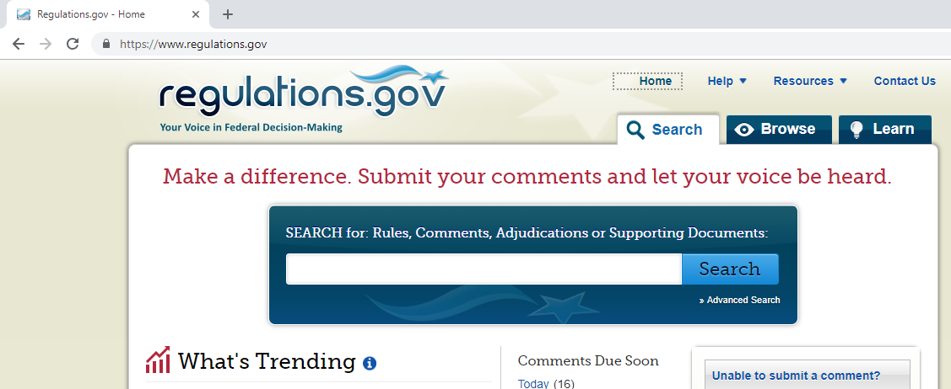
Navigate to Regulations.gov
Type in www.regulations.gov in the address bar

Slide 3
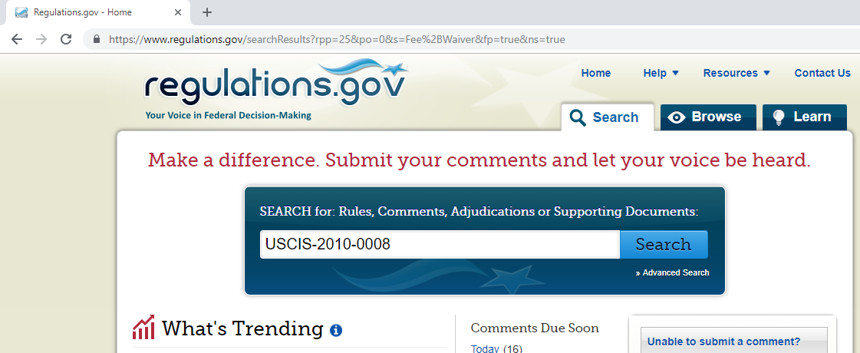
Find the Rule
Type in the Docket ID number for the Rule on which you want to comment

Slide 4
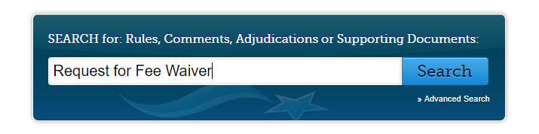
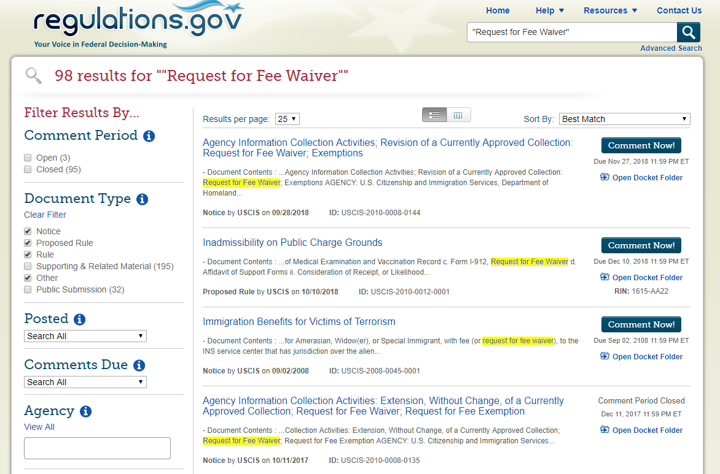
If you don’t have the Docket ID…
If you don’t have the Docket ID, you can search by the title of the rule or by key words
Browse the results for the rule you want to comment on.
If you don’t see the rule in the results, try filtering for comment period open, and what agency issued the rule.

Slide 5
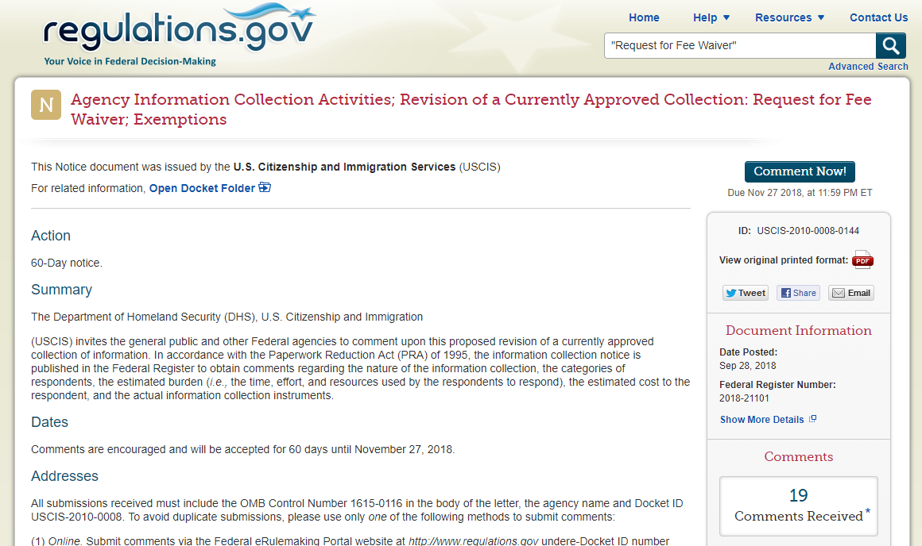
Anatomy of the Rule Page
Click to Comment
Open the Docket Folder to see attachments
Comment due date
You can read the rule here
Read other people’s comments

Slide 6
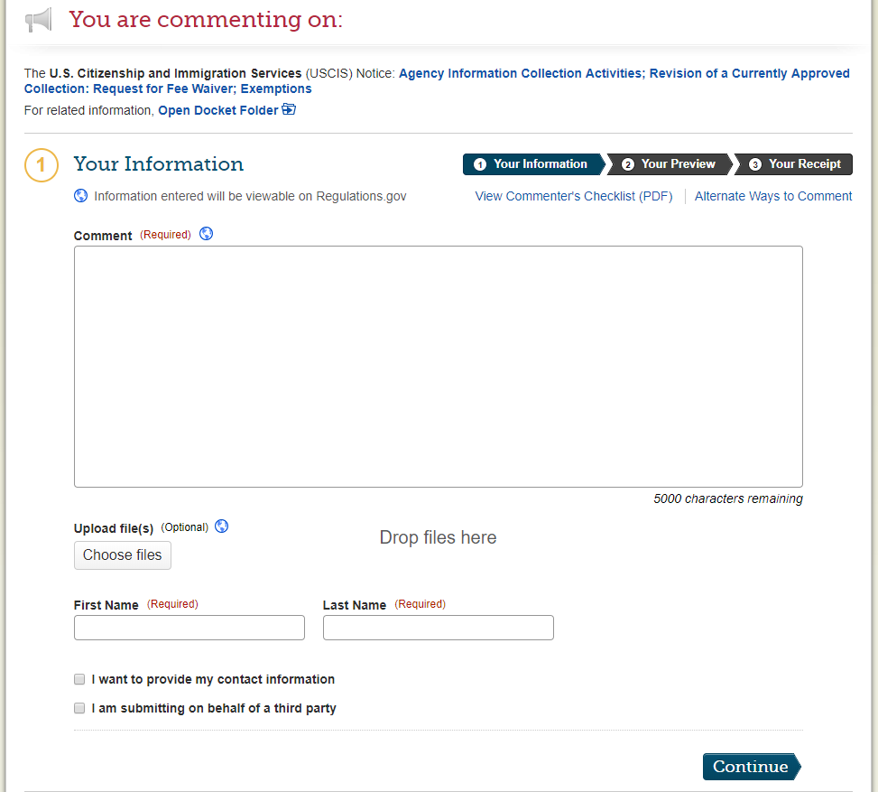
Comment!
Click the “Comment Now” button as shown on the previous slide.
Type or paste your comment in the box
or
Type in the box that your comment is attached, and upload your pre-written comment (preferably in PDF format)
5000 character limit
Your name is required
Your contact information is optional
Continue

Slide 7
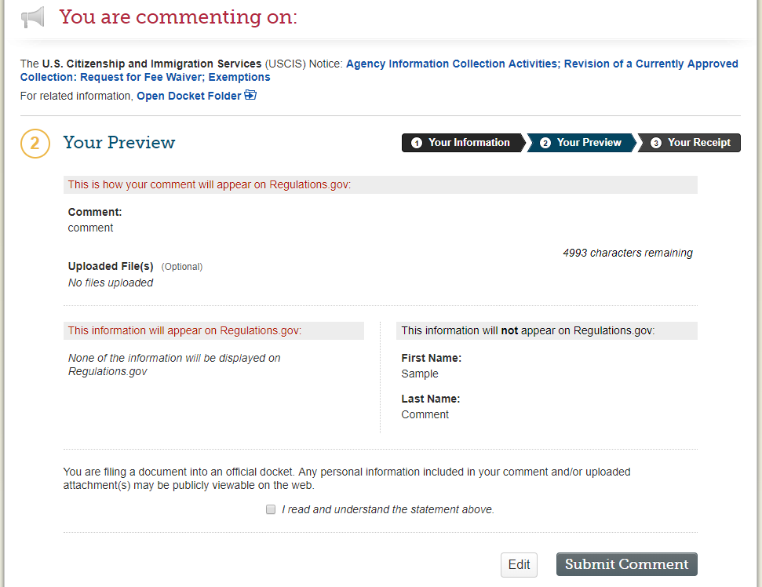
Preview your Comment, then Submit
Review your comment or uploaded files. They will be available to the public.
This information will not be public
Read and check the box
Submit

Slide 8
Questions?
If you are a CLINIC affiliate and have any questions about commenting or encounter problems while trying to submit a comment, contact:
advocacy@cliniclegal.org
If you are commenting on a rule in response to a CLINIC campaign requesting your participation, please report your participation back to us either on a CLINIC webpage dedicated to the rule you are commenting on, or at the email address above.

